Slide 1
GRU Model – Exhaustive Feature Selection via Grid Search v2.0
Test Accuracy Results

Slide 2
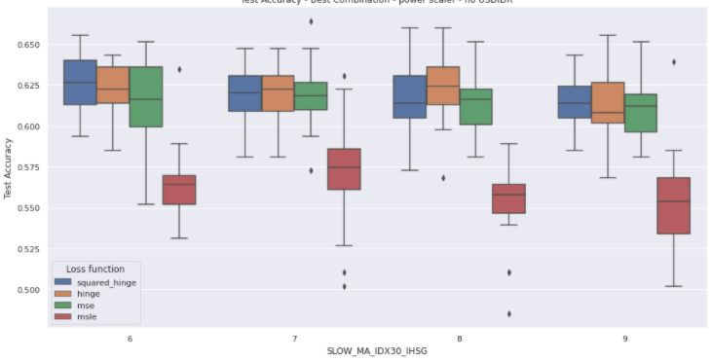
Comparison of Test Accuracy with varying loss function
Features : [momentum, IDX30_IHSG_grad, EIDO_SPY_grad, Volume_grad] Scaler: StandardScaler
Combination # | Combi - 4 | Combi - 14 | Combi - 21 | Combi - 28
SLOW_MA_EIDO_SPY | 6 | 6 | 6 | 6
FAST_MA_EIDO_SPY | 6 | 6 | 6 | 6
SLOW_MA_IDX30_IHSG | 6 | 7 | 8 | 9
FAST_MA_IDX30_IHSG | 6 | 5 | 4 | 3
SLOW_MA_Volume | 9 | 10 | 9 | 9
FAST_MA_Volume | 7 | 6 | 7 | 7

Slide 3
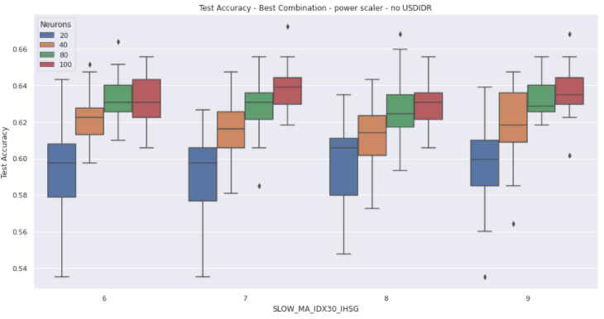
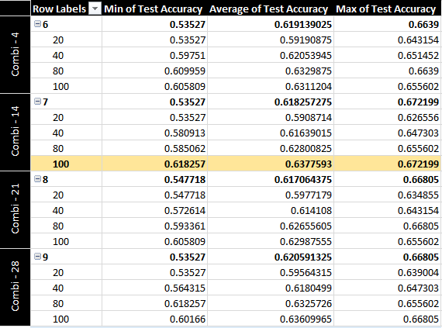
Comparison of Test Accuracy with varying # of Neurons (20, 40, 80, 100)
Features : [momentum, IDX30_IHSG_grad, EIDO_SPY_grad, Volume_grad] Scaler: StandardScaler – Loss: hinge
Combination # | Combi - 4 | Combi - 14 | Combi - 21 | Combi - 28
SLOW_MA_EIDO_SPY | 6 | 6 | 6 | 6
FAST_MA_EIDO_SPY | 6 | 6 | 6 | 6
SLOW_MA_IDX30_IHSG | 6 | 7 | 8 | 9
FAST_MA_IDX30_IHSG | 6 | 5 | 4 | 3
SLOW_MA_Volume | 9 | 10 | 9 | 9
FAST_MA_Volume | 7 | 6 | 7 | 7

Slide 4
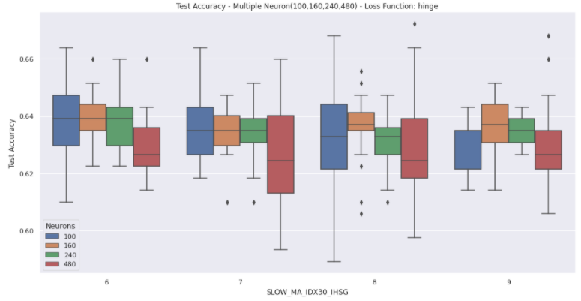
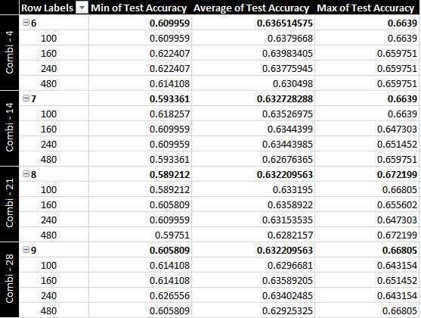
Comparison of Test Accuracy with varying # of Neurons (100, 160, 240, 480)
Features : [momentum, IDX30_IHSG_grad, EIDO_SPY_grad, Volume_grad] Scaler: StandardScaler – Loss: hinge
Combination # | Combi - 4 | Combi - 14 | Combi - 21 | Combi - 28
SLOW_MA_EIDO_SPY | 6 | 6 | 6 | 6
FAST_MA_EIDO_SPY | 6 | 6 | 6 | 6
SLOW_MA_IDX30_IHSG | 6 | 7 | 8 | 9
FAST_MA_IDX30_IHSG | 6 | 5 | 4 | 3
SLOW_MA_Volume | 9 | 10 | 9 | 9
FAST_MA_Volume | 7 | 6 | 7 | 7

Slide 5
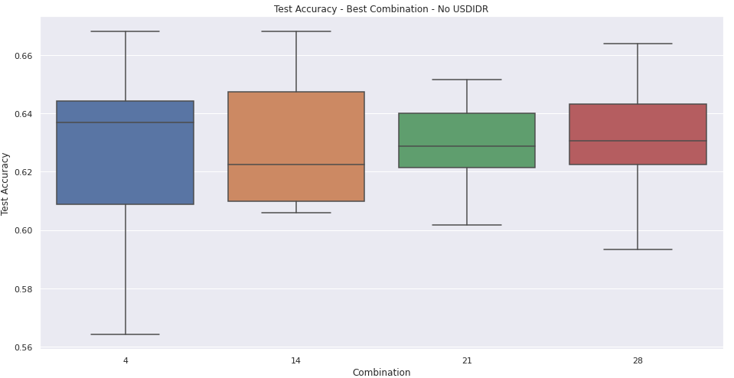
Comparison of Test Accuracy with Best FAST_MA and SLOW_MA parameter – no USDIDR
Features : [momentum, IDX30_IHSG_grad, EIDO_SPY_grad, Volume_grad]
Combination # | Combi - 4 | Combi - 14 | Combi - 21 | Combi - 28
SLOW_MA_EIDO_SPY | 6 | 6 | 6 | 6
FAST_MA_EIDO_SPY | 6 | 6 | 6 | 6
SLOW_MA_IDX30_IHSG | 6 | 7 | 8 | 9
FAST_MA_IDX30_IHSG | 6 | 5 | 4 | 3
SLOW_MA_Volume | 9 | 10 | 9 | 9
FAST_MA_Volume | 7 | 6 | 7 | 7

Slide 6
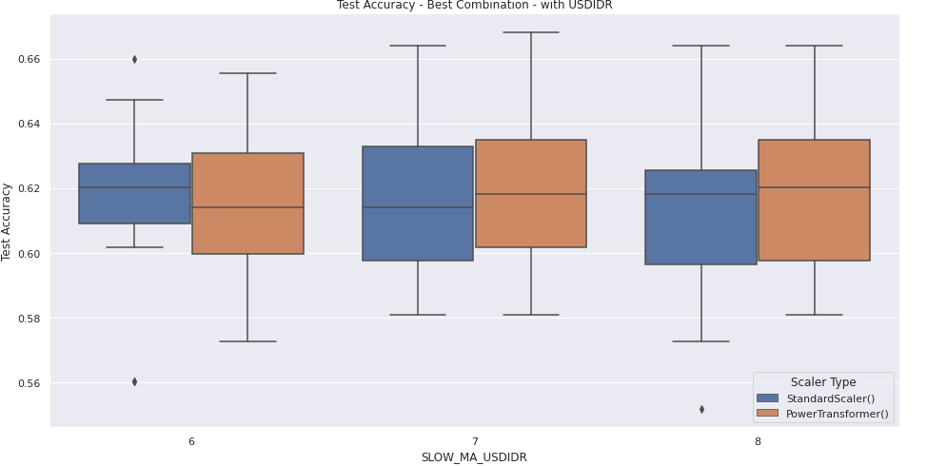
Comparison of Test Accuracy with USDIDR parameter
Lower overall accuracy compared to model without USDIDR parameter
Combination # | Combi - 14
SLOW_MA_EIDO_SPY | 6
FAST_MA_EIDO_SPY | 6
SLOW_MA_IDX30_IHSG | 7
FAST_MA_IDX30_IHSG | 5
SLOW_MA_Volume | 10
FAST_MA_Volume | 6

Slide 7
Top 20 Combination from Grid Search (Combination 0-49)
Combination | Min of Test Accuracy | Average of Test Accuracy | Max of Test Accuracy | SLOW_MA_EIDO_SPY | FAST_MA_EIDO_SPY | SLOW_MA_IDX30_IHSG | FAST_MA_IDX30_IHSG | SLOW_MA_Volume | FAST_MA_Volume
28 | 0.593361 | 0.6294607 | 0.6639 | 6 | 6 | 9 | 3 | 9 | 7
21 | 0.60166 | 0.6294606 | 0.651452 | 6 | 6 | 8 | 4 | 9 | 7
14 | 0.605809 | 0.62925325 | 0.66805 | 6 | 6 | 7 | 5 | 10 | 6
4 | 0.564315 | 0.62925315 | 0.66805 | 6 | 6 | 6 | 6 | 9 | 7
6 | 0.576763 | 0.62883825 | 0.6639 | 6 | 6 | 6 | 6 | 8 | 6
40 | 0.59751 | 0.6238588 | 0.672199 | 6 | 6 | 10 | 6 | 10 | 6
5 | 0.547718 | 0.62365145 | 0.66805 | 6 | 6 | 6 | 6 | 10 | 6
46 | 0.589212 | 0.62095445 | 0.643154 | 6 | 6 | 8 | 6 | 9 | 5
16 | 0.576763 | 0.6209544 | 0.6639 | 6 | 6 | 7 | 5 | 9 | 5
22 | 0.585062 | 0.6197096 | 0.647303 | 6 | 6 | 8 | 4 | 10 | 6
15 | 0.576763 | 0.61929475 | 0.651452 | 6 | 6 | 7 | 5 | 8 | 6
13 | 0.568465 | 0.61887975 | 0.643154 | 6 | 6 | 7 | 5 | 9 | 7
2 | 0.572614 | 0.61722 | 0.655602 | 6 | 6 | 6 | 6 | 8 | 4
34 | 0.564315 | 0.61721995 | 0.651452 | 6 | 6 | 9 | 7 | 9 | 7
10 | 0.589212 | 0.6172199 | 0.659751 | 6 | 6 | 7 | 5 | 7 | 5
8 | 0.576763 | 0.6170125 | 0.659751 | 6 | 6 | 6 | 6 | 10 | 4
29 | 0.576763 | 0.61639005 | 0.655602 | 6 | 6 | 9 | 3 | 10 | 6

Slide 8
Top 20 Combination from Grid Search (Combination 50-99)
Combination | Min of Test Accuracy | Average of Test Accuracy | Max of Test Accuracy | SLOW_MA_EIDO_SPY | FAST_MA_EIDO_SPY | SLOW_MA_IDX30_IHSG | FAST_MA_IDX30_IHSG | SLOW_MA_Volume | FAST_MA_Volume
58 | 0.593361 | 0.61784235 | 0.651452 | 7 | 5 | 7 | 5 | 9 | 7
73 | 0.576763 | 0.61763485 | 0.655602 | 7 | 5 | 9 | 3 | 9 | 7
61 | 0.572614 | 0.61701245 | 0.651452 | 7 | 5 | 7 | 5 | 9 | 5
59 | 0.585062 | 0.6157677 | 0.659751 | 7 | 5 | 7 | 5 | 10 | 6
79 | 0.585062 | 0.614523 | 0.643154 | 7 | 5 | 9 | 7 | 9 | 7
75 | 0.580913 | 0.6143155 | 0.651452 | 7 | 5 | 9 | 3 | 8 | 6
69 | 0.580913 | 0.6143154 | 0.659751 | 7 | 5 | 8 | 4 | 9 | 5
82 | 0.551867 | 0.61348565 | 0.643154 | 7 | 5 | 9 | 7 | 9 | 5
67 | 0.568465 | 0.6120333 | 0.643154 | 7 | 5 | 8 | 4 | 10 | 6
94 | 0.564315 | 0.61182585 | 0.647303 | 7 | 5 | 9 | 5 | 9 | 5
80 | 0.564315 | 0.6116183 | 0.651452 | 7 | 5 | 9 | 7 | 10 | 6
78 | 0.580913 | 0.61141085 | 0.651452 | 7 | 5 | 9 | 3 | 11 | 3
87 | 0.576763 | 0.61078845 | 0.634855 | 7 | 5 | 10 | 6 | 9 | 5
64 | 0.53112 | 0.60995855 | 0.651452 | 7 | 5 | 8 | 4 | 8 | 4
60 | 0.580913 | 0.60954365 | 0.630705 | 7 | 5 | 7 | 5 | 8 | 6
86 | 0.556017 | 0.60933625 | 0.643154 | 7 | 5 | 10 | 6 | 8 | 6
90 | 0.547718 | 0.60933615 | 0.651452 | 7 | 5 | 8 | 6 | 8 | 6

Slide 9
Last 20 Combination from Grid Search (Combination 200-219)
Combination # | Min of Test Accuracy | Average of Test Accuracy | Max of Test Accuracy | SLOW_MA_EIDO_SPY | FAST_MA_EIDO_SPY | SLOW_MA_IDX30_IHSG | FAST_MA_IDX30_IHSG | SLOW_MA_Volume | FAST_MA_Volume
200 | 0.543568 | 0.61244805 | 0.647303 | 8 | 6 | 8 | 6 | 8 | 6
201 | 0.53527 | 0.6056017 | 0.639004 | 8 | 6 | 8 | 6 | 9 | 5
202 | 0.572614 | 0.60477185 | 0.643154 | 8 | 6 | 8 | 6 | 10 | 4
203 | 0.572614 | 0.5993777 | 0.634855 | 8 | 6 | 8 | 6 | 11 | 3
204 | 0.560166 | 0.6010374 | 0.643154 | 8 | 6 | 9 | 5 | 9 | 5
205 | 0.585062 | 0.61037335 | 0.651452 | 8 | 6 | 9 | 5 | 10 | 4
206 | 0.564315 | 0.6010374 | 0.647303 | 8 | 6 | 9 | 5 | 11 | 3
207 | 0.556017 | 0.5923237 | 0.639004 | 8 | 6 | 10 | 4 | 10 | 4
208 | 0.572614 | 0.60082985 | 0.634855 | 8 | 6 | 10 | 4 | 11 | 3
209 | 0.568465 | 0.5993776 | 0.626556 | 8 | 6 | 11 | 3 | 11 | 3
210 | 0.576763 | 0.60829865 | 0.655602 | 9 | 5 | 9 | 5 | 9 | 5
211 | 0.539419 | 0.6076763 | 0.66805 | 9 | 5 | 9 | 5 | 10 | 4
212 | 0.556017 | 0.59792525 | 0.634855 | 9 | 5 | 9 | 5 | 11 | 3
213 | 0.551867 | 0.5919086 | 0.622407 | 9 | 5 | 10 | 4 | 10 | 4
214 | 0.556017 | 0.5981329 | 0.626556 | 9 | 5 | 10 | 4 | 11 | 3
215 | 0.543568 | 0.6018672 | 0.643154 | 9 | 5 | 11 | 3 | 11 | 3
216 | 0.560166 | 0.5970954 | 0.639004 | 10 | 4 | 10 | 4 | 10 | 4
217 | 0.551867 | 0.59460575 | 0.659751 | 10 | 4 | 10 | 4 | 11 | 3
218 | 0.560166 | 0.5948132 | 0.639004 | 10 | 4 | 11 | 3 | 11 | 3
219 | 0.560166 | 0.5977178 | 0.643154 | 11 | 3 | 11 | 3 | 11 | 3

